Slide 1

DECREASING THE INCIDENCE OF PPPH IN OLANREWAJU HOSPITAL A quality improvement project
Notes:
Administer pre-seminar assessment here

Slide 2
Team Members
Balogun Stephen T. (MB; BS, FISQua, SSGB)
Oyinloye Omotayo A. (MB; BS, Associate Fellow ISQua)
Opeyemi Muinat O. (RN)
Onifade Titilayo R. (RN)

Slide 3
CONTENTS
Introduction
Seminar
Antenatal preparation
Intrapartum care
Postpartum care
Summary
Conclusion

Slide 4
INTRODUCTION
Definition of PPPH: the loss of 500 mL or more of blood within the first 24 hours after birth
It is a leading cause of maternal morbidity and mortality
Estimated 14 million cases of pregnancy-related haemorrhage annually
Of which there are about 150 000 deaths
A woman can die within 2 hours after the onset of PPH if she does not receive proper treatment

Slide 5
INCIDENCE OF PPH
Incidence of PPH (foreign and national)
JUTH 0.95%
UITH 4.5%
WHO 2%
ACOG 4-6%

Slide 6
INCIDENCE IN OLANREWAJU HOSPITAL
Data was collected between January 2014 – April 2015
 | PPPH | Episiotomy | Perineal tear
Mean | 16.3 | 22.4 | 44.0
Min | 5.0 | 10.0 | 29.4
Median | 17.5 | 20.6 | 44.0
Max | 29.4 | 37.0 | 66.7

Slide 7
INCIDENCE (CONT’D)

Slide 8
INCIDENCE (CONT’D)

Slide 9
INCIDENCE (CONT’D)

Slide 10
INTRODUCTION (CONT’D)
The goal of the project is to reduce the incidence of PPPH to <10% by December 2015
Method of Achieving Goal:
Implementation of several phases of improvement plans, the first of which is this seminar presentation.

Slide 11
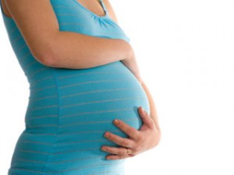
ANC PREPARATION

Slide 12
ANC Preparation
Identify risk factors for postpartum haemorrhage (if any)
Multiple pregnancy
Previous PPPH
Fibroid in pregnancy
Polyhydramnois
Abnormal placentation
ALL PATIENTS HOWEVER ARE AT RISK OF PPH
Notes:
Predicting who will have PPH based on risk factors is difficult because two-thirds of
women who have PPH have no risk factors. Therefore, all women are considered at
risk, and hemorrhage prevention must be incorporated into care provided at every birth

Slide 13
ANC Preparation (cont’d)
Optimise maternal PCV
Ensure patient is commenced on haematinics early
Ensure patient is regular on haematinics
Prompt identification and treatment of malaria in pregnancy
prepare patient for labour and delivery.
Ensure communication of action plans with patient to encourage compliance.
Notes:
This is in addition to all other routine ANC care of patient

Slide 14

INTRAPARTUM CARE

Slide 15
First Stage of Labour(Cont’d)
Control pain
Ambulate patient
Provide emotional support (partner)
Breathing exercise
Analgesics
Judicious augmentation of patient with indication
Establish rapport with the patient

Slide 16
Second Stage of Labour
Routine emptying of the bladder
Wait till crowning of foetal head before transfer to delivery room
Do not give fundal pressure to assist delivery of the baby
Do not perform routine episiotomy
Proper guarding of the perineum to avoid perineal tear
Role of communication
Notes:
Perineal guarding: Place the fingers of one hand against the baby’s head to keep
it flexed (bent), support the perineum, and instruct the woman to use breathing
techniques to push or stop pushing.

Slide 17
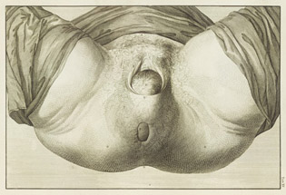
Second Stage of Labour (Cont’d)
Crowning of foetal head
Notes:
The labia are stretched in a crown around the head
The anal sphincter widens with each contraction
The foetal head does not recede completely back inside the vaginal after uterine contraction

Slide 18
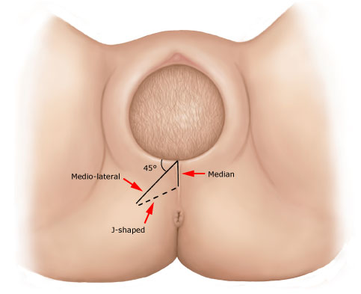
Second Stage of Labour (cont’d)
episiotomy

Slide 19
Third Stage of Labour
Active Management of Third Stage of Labour (AMTSL)
Routine emptying of the bladder
Do not perform CCT without administering uterotonics
Do not perform CCT without counter traction to support the uterus
Continue communication with patient

Slide 20
AMTSL
Studies have shown that AMTSL decreases:
Incidence of PPH
Length of third stage of labour
Percentage of third stages of labour lasting longer than 30 minutes
Need for blood transfusion
Need for uterotonic drugs to manage PPH.

Slide 21
Factors | Study | Management
 |  | Active | Physiologic
PPH | Bristol | 5.9% | 17.9 %
 | Hinchingbrooke | 6.8 % | 16.5%
Average length of the third stage of labour | Bristol | 5 minutes | 15 minutes
 | Hinchingbrooke | 8 minutes | 15 minutes
Third stage of labour longer than 30 minutes | Bristol | 2.9% | 26%
 | Hinchingbrooke | 3.3% | 16.4%
Blood transfusion needed | Bristol | 2.1% | 5.6%
 | Hinchingbrooke | 0.5% | 2.6%
Additional uterotonics drugs needed to manage PPH | Bristol | 6.4% | 29.7%
 | Hinchingbrooke | 3.2% | 21.1%
Notes:
Bristol and Hinchingbrooke study results comparing active and
Physiologic (expectant) management of the third stage of labor

Slide 22
Active Management of Third Stage of Labour
After the delivery of the baby, palpate the mother’s uterus to rule-out the presence of another baby
Give uterotonics within one minute of delivery of the baby
Perform controlled cord traction (CCT)
Massage the uterus through the abdomen after delivery of the placenta to keep the uterus well contracted

Slide 23
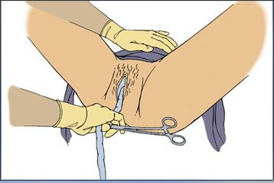
Before performing AMTSL, palpate the mother’s uterus to rule-out the presence of another baby

Slide 24
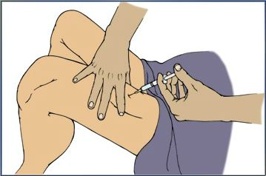
Begin AMTSL by giving the uterotonics in the upper thigh within one minute of delivery of the baby

Slide 25
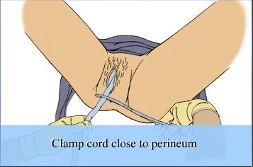
Clamp the umbilical cord close to the perineum
Notes:
Re-adjust the clamp ad put it close to the perineum

Slide 26
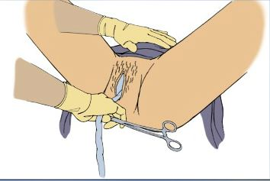
Prepare hands for the procedure by putting one hand on the uterine fundus and the other on the cord clamp while waiting for the next uterine contraction. Do not pull on the cord during this stage
Notes:
Keep light tension on the cord while waiting for the next uterine contraction. The next contraction should occur within the next 2-3 minutes.

Slide 27
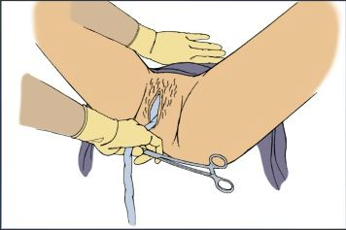
During the next strong contraction, gently apply steady traction to the cord while applying steady counter-pressure to the uterus
Notes:
If the placenta does not deliver within 30-40 seconds, relax and wait for the next strong contraction before applying traction on the cord

Slide 28
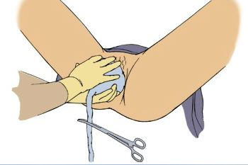
As the placenta delivers, hold it with both hands

Slide 29
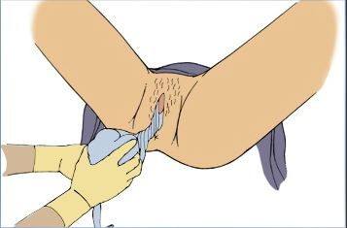
If the membranes do not slip out spontaneously, gently twist them into a rope and move them up and down gently to assist their separation from the uterus without tearing them.

Slide 30
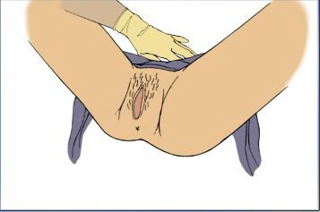
After the delivery of the placenta, rub the uterus and ensure that it is contracted

Slide 31
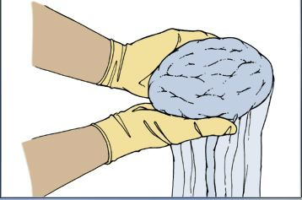
Check the placenta for completeness
Notes:
Hold the placenta in the palms of your hands, with the maternal side facing upwards; and make sure that all lobules are present and fit together

Slide 32
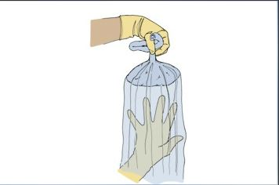
…Check the placenta for completeness
Notes:
Then hold the cord with one hand, allowing the placenta and membranes to hang down

Slide 33
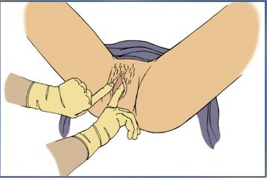
Gently separate the labia and inspect the lower vagina and perineum for lacerations that may need to be repaired to prevent further blood loss
Notes:
Cervical examination is only recommended when the cause of PPH
has not been diagnosed and uterine atony, lower genital lacerations, and retained
placenta are ruled out.

Slide 34
AMTSL step-by-step demonstration
AMTSL step-by-step demonstration
Notes:
Click on section 27

Slide 35
Review of Repair of Perineal Tear
repair of perineal tear/episiotomy
online video of episiotomy repair

Slide 36

POSTPARTUM PERIOD

Slide 37
POSTPARTUM PERIOD
The immediate postpartum period (also known as the fourth stage of labour) is very important for the prevention of PPPH.
This period begins with delivery of the placenta and goes from one to six hours after delivery of the placenta, or until the uterus remains firm on its own.

Slide 38
POSTPARTUM PERIOD (CONT’D)
In this stabilization phase, the uterus makes its initial readjustment to the non-pregnant state.
The primary goal is to prevent hemorrhage from
uterine atony and
cervical or vaginal lacerations.

Slide 39
POSTPARTUM PERIOD (CONT’D)
Keep the urinary bladder empty
Routinely inspect the patient
Palpate the uterine fundus and ensure it remains contracted
Check the perineal pad
Check maternal pulse and blood pressure
Explain to the patient early symptoms and signs of bleeding and what to do in case she experiences any of such
Assist the patient to commence lactation as soon as possible after birth in the absence of any contraindication
Notes:
Encourage patient to void or assist if necessary. Take care to explain the importance to the patient. Carry out all other routine postpartum care as necessary.

Slide 40
FREQUENTLY ASKED QUESTIONS
QUESTION 1
If the woman has an IV oxytocin infusion running at the time the baby is born, how should oxytocin be delivered (dosage and route)?
ANSWER
In patients on IV oxytocin infusion, the provider should increase the rate of oxytocin infusion (60dpm) for about 2-5mins, thereafter regulate to about 20-30dpm for some period (30-60mins) after birth.
QUESTION 2
What is the role of misoprostol in the prevention and management of PPH?
ANSWER
Misoprostol is recommended for prevention and treatment only in situations where injectable uterotonics are not available.

Slide 41
FREQUENTLY ASKED QUESTIONS (CONT’D)
QUESTION 3
What is the recommended treatment for a patient with PPH
ANSWER
The recommended treatment is IV oxytocin 20-40 IU in 500mL of N/S

Slide 42
SUMMARY
Prevent anaemia in pregnancy
Ensure patient takes haematinics
Prompt treatment of malaria
Identify high risk patients
Note however that 2/3 of PPH occurs in patients without risks. Therefore, all pregnancies are at risk
Establish interpersonal relationship with your patient

Slide 43
SUMMARY (CONT’D)
Ensure urinary bladder is empty throughout labour and immediate delivery period
Avoid patient bearing down before full cervical dilatation
Avoid routine episiotomy
Perform AMTSL
Monitor patient closely in the immediate postpartum period

Slide 44
CONCLUSION
The present incidence of PPH in this facility is high
The management is determined to decrease this incidence
Achieving this requires the cooperative effort of all
The aim is to decrease the incidence to consistently below 10% before the of the year
This seminar is the first of the efforts aimed at achieving this target
Data will be collected routinely to measure improvements.
Notes:
Administer post-seminar assessment here.

Slide 45
FURTHER READING
Active Management of the Third Stage of Labour: http://www.accesstohealth.org/toolres/amtslweb/amtsl.html
Global Health Learning certificate course on Postpartum Haemorrhage http://www.globalhealthlearning.org/course/preventing-postpartum-hemorrhage
Episiotomy And Perineal Tear Repair: Seminar presentation at Olanrewaju Hospital 8th June, 2014.

Slide 46

QUESTIONS

Slide 47
REFERENCES
Incidence of Primary Postpartum Haemorrhage in a Private Hospital in Kwara State, Nigeria, a Quality Improvement Project.
Active Management of the Third Stage of Labour: http://www.accesstohealth.org/toolres/amtslweb/amtsl.html
Global Health Learning certificate course on Postpartum Haemorrhage http://www.globalhealthlearning.org/course/preventing-postpartum-hemorrhage
Prevention of Postpartum Hemorrhage: Implementing Active Management of the Third Stage of Labor (AMTSL); Prevention of Postpartum Haemorrhage Initiative (POPPHI) 2007.
Episiotomy And Perineal Tear Repair: Seminar presentation at Olanrewaju Hospital 8th June, 2014.

